Slide 1
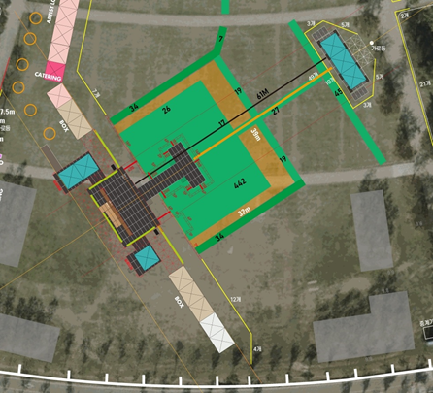

Slide 2
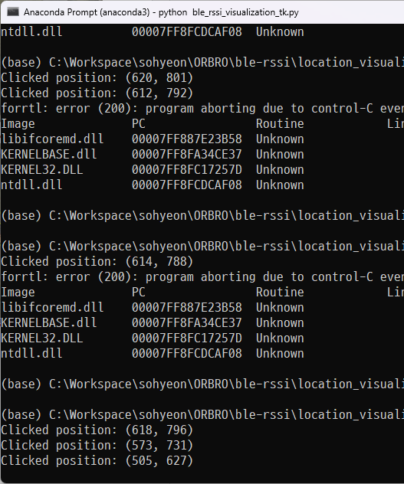
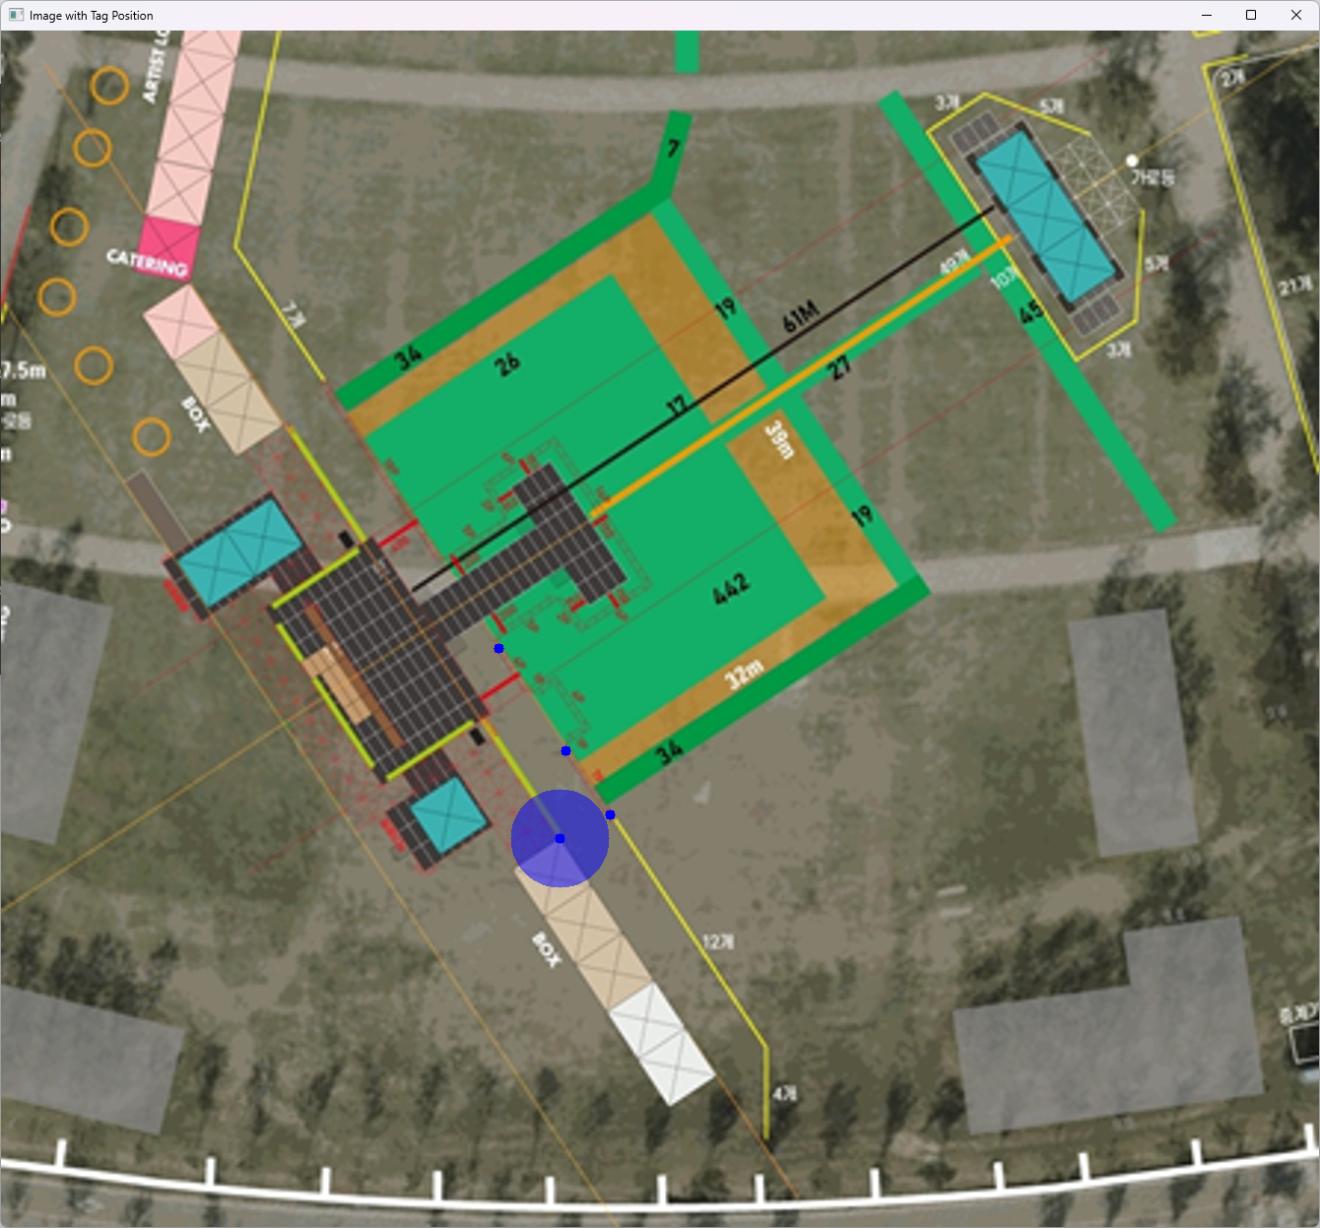
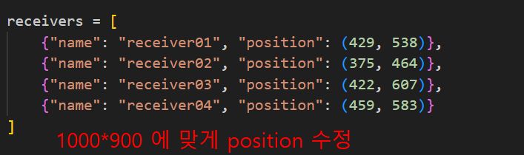
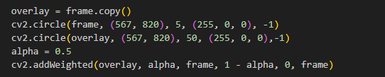
2
1
4
3
4
1
2
3
약 50이 5m

Slide 3
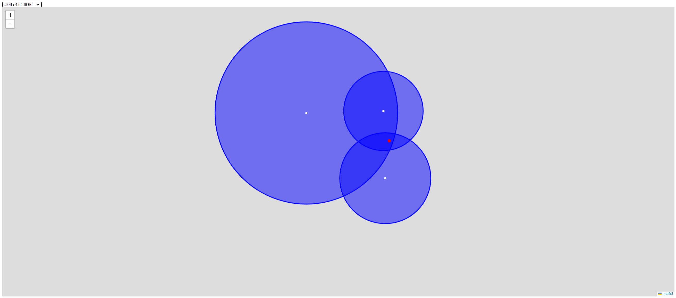
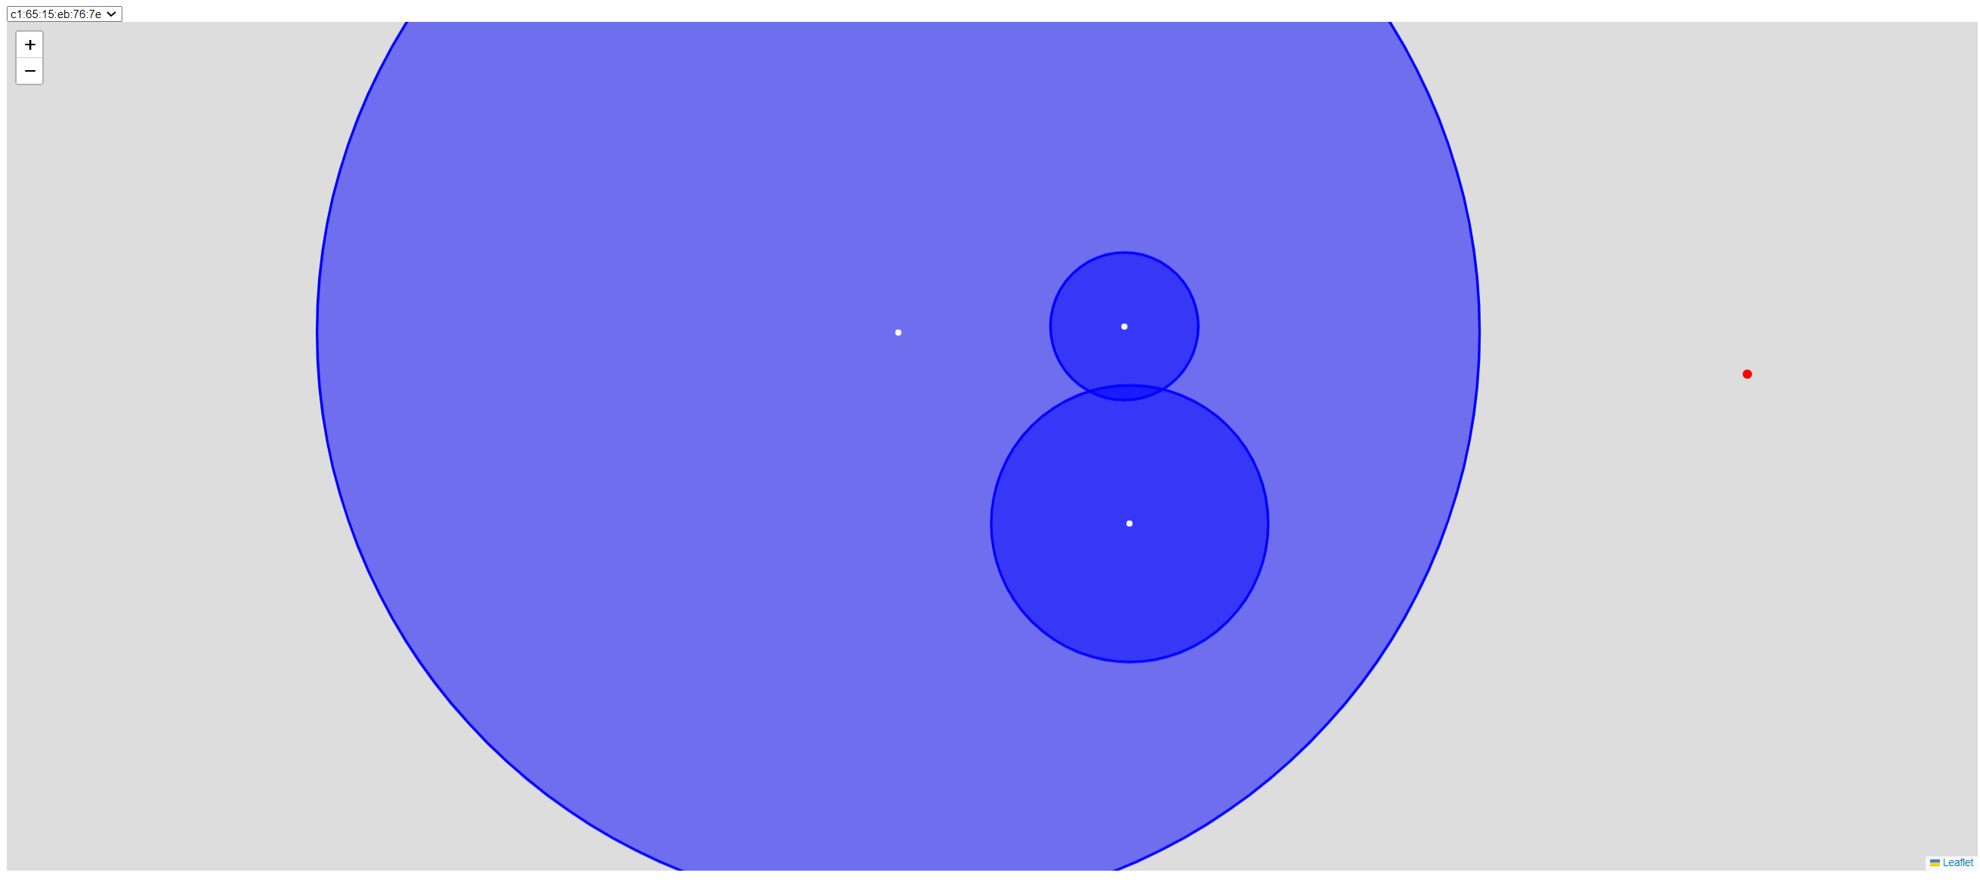

Slide 4
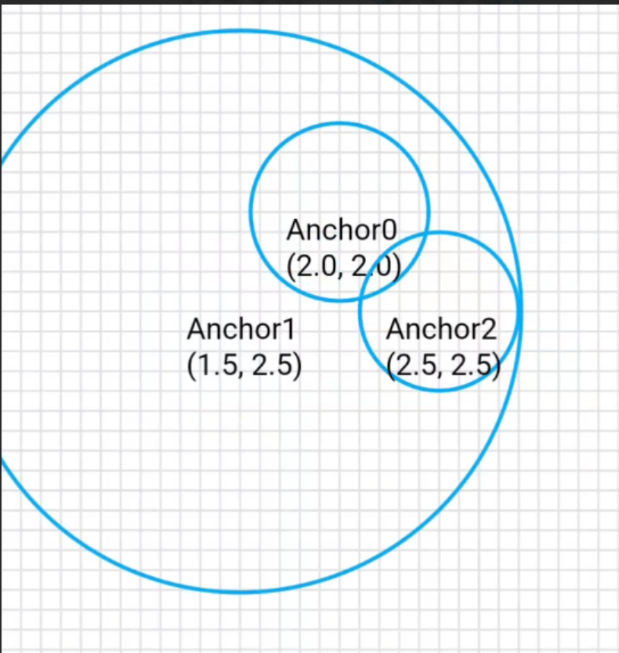
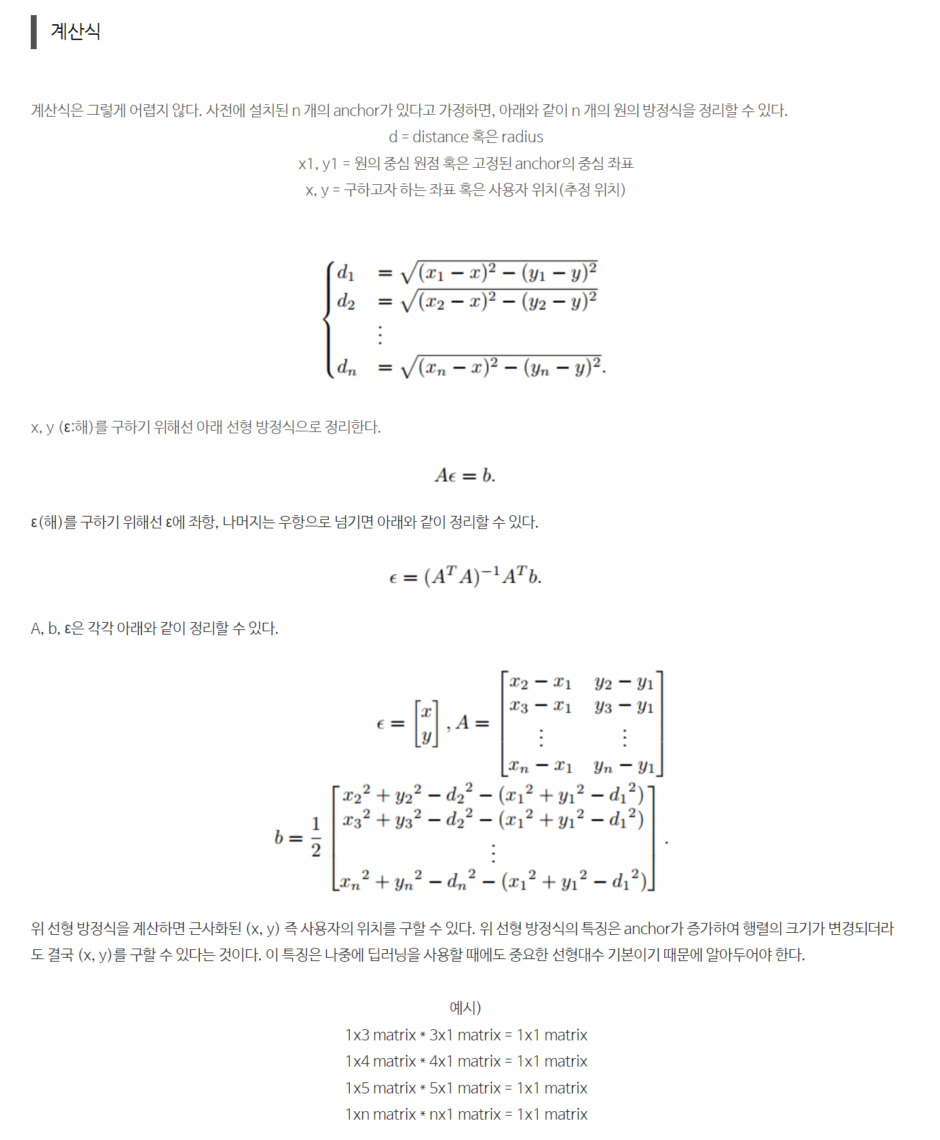
https://blog.naver.com/younjung1996/223363808851
def trilateration(distances, positions):
matrixA = []
matrixB = []
x0, y0, r0 = distances[0]['centerX'], distances[0]['centerY'], distances[0]['distance']
for idx in range(1, len(distances)) :
x,y,r = distances[idx]['centerX'], distances[idx]['centerY'], distances[idx]['distance']
matrixA.append([x - x0, y - y0])
matrixB.append([
(x**2 + y**2 - r**2) - (x0**2 + y0**2 - r0**2)
])
matrixA = np.array(matrixA)
matrixB = np.array(matrixB).reshape(-1, 1) / 2 # 나눗셈은 2로 나눈 결과로 처리
# (A^T * A)^-1 * A^T * B 계산
matrixA_transpose = matrixA.T
matrix_inverse = np.linalg.inv(np.dot(matrixA_transpose, matrixA))
matrix_dot = np.dot(matrix_inverse, matrixA_transpose)
position = np.dot(matrix_dot, matrixB)
return position.flatten()

Slide 5
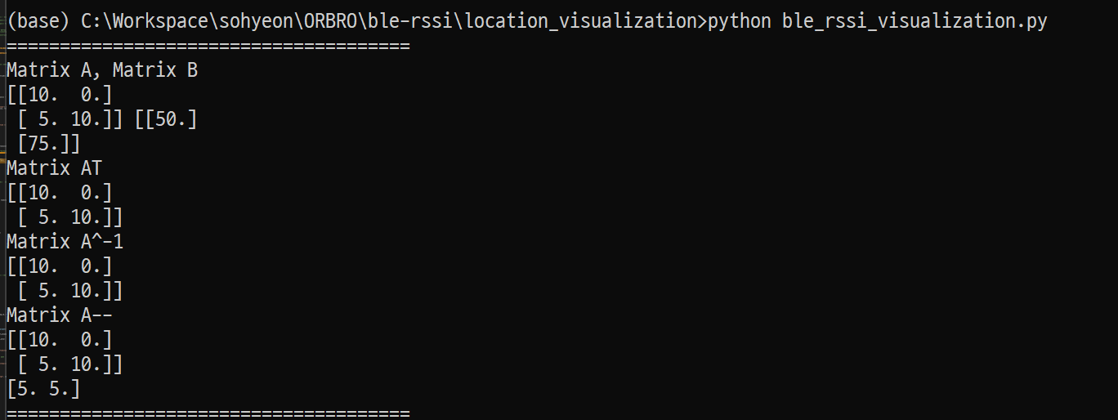
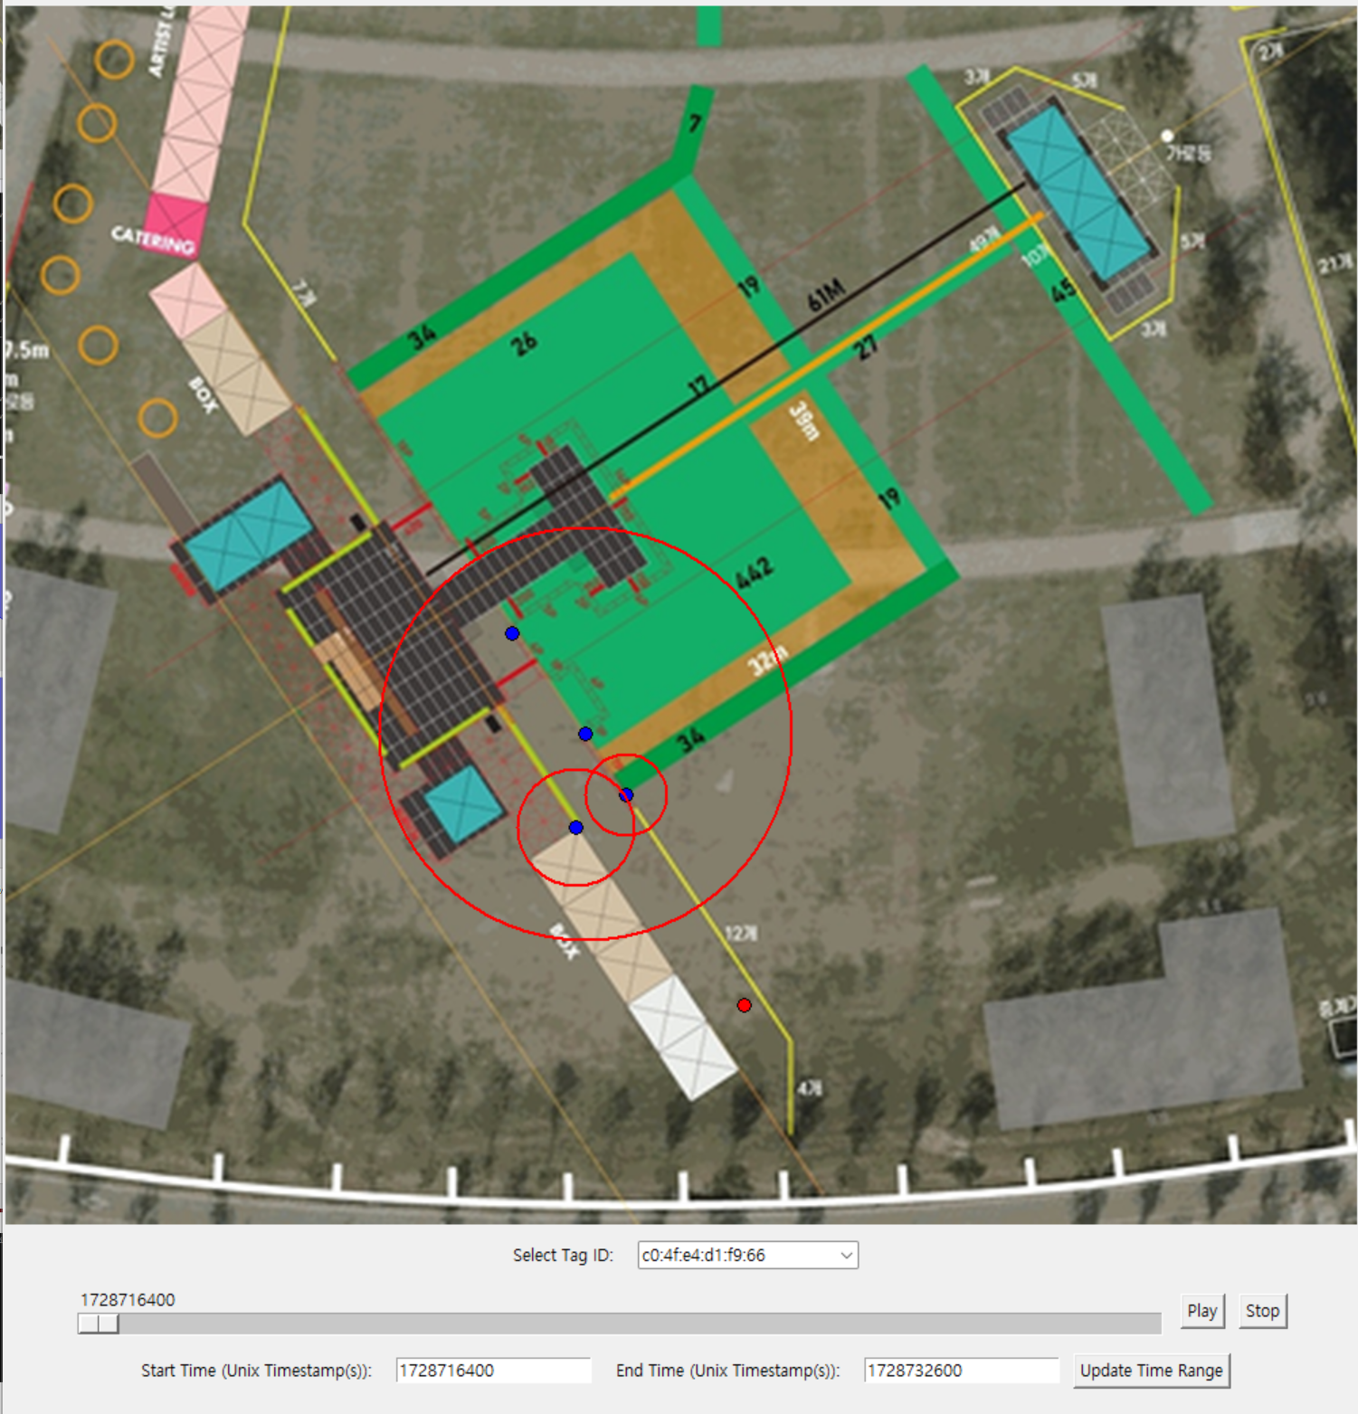
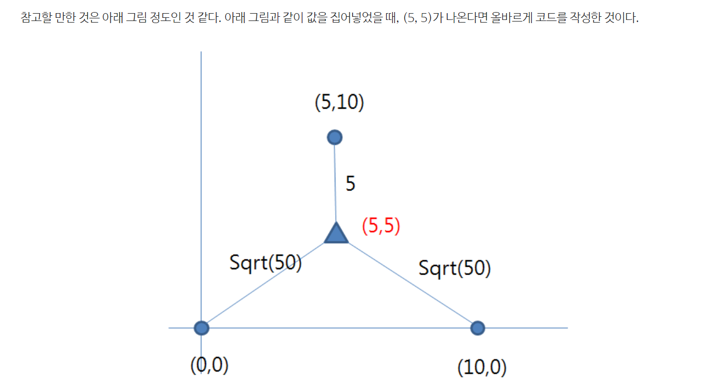
https://www.youtube.com/shorts/BM-Lp7D-las

Slide 6
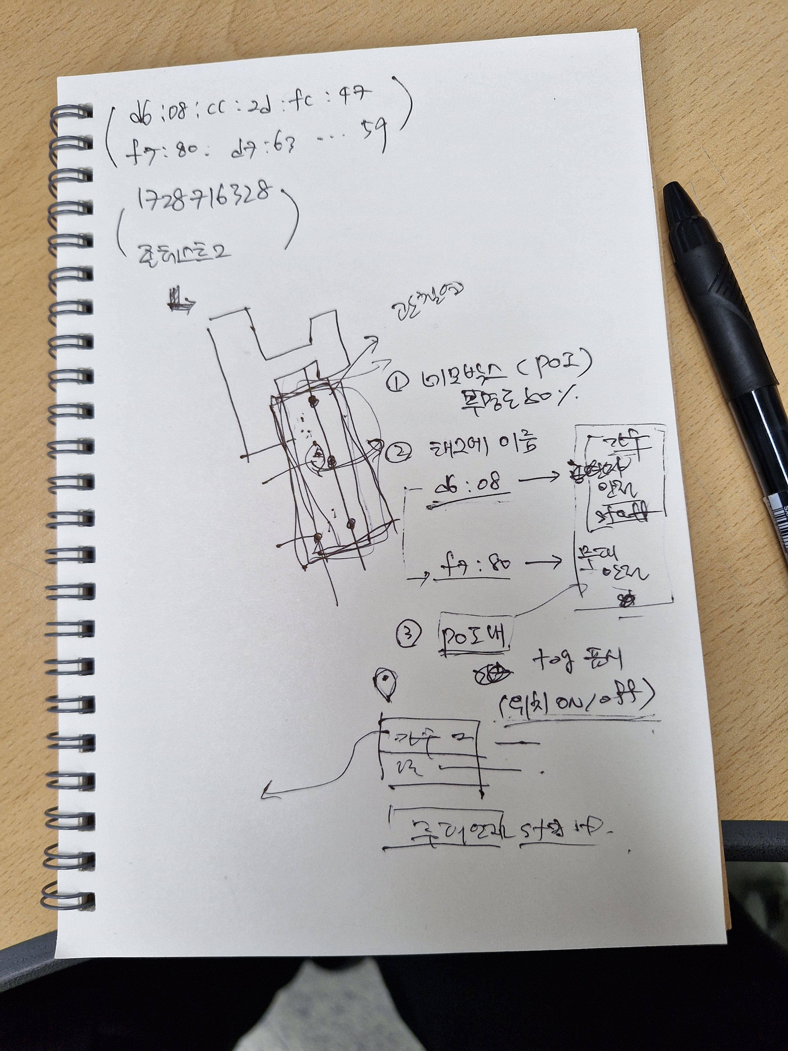

Slide 7
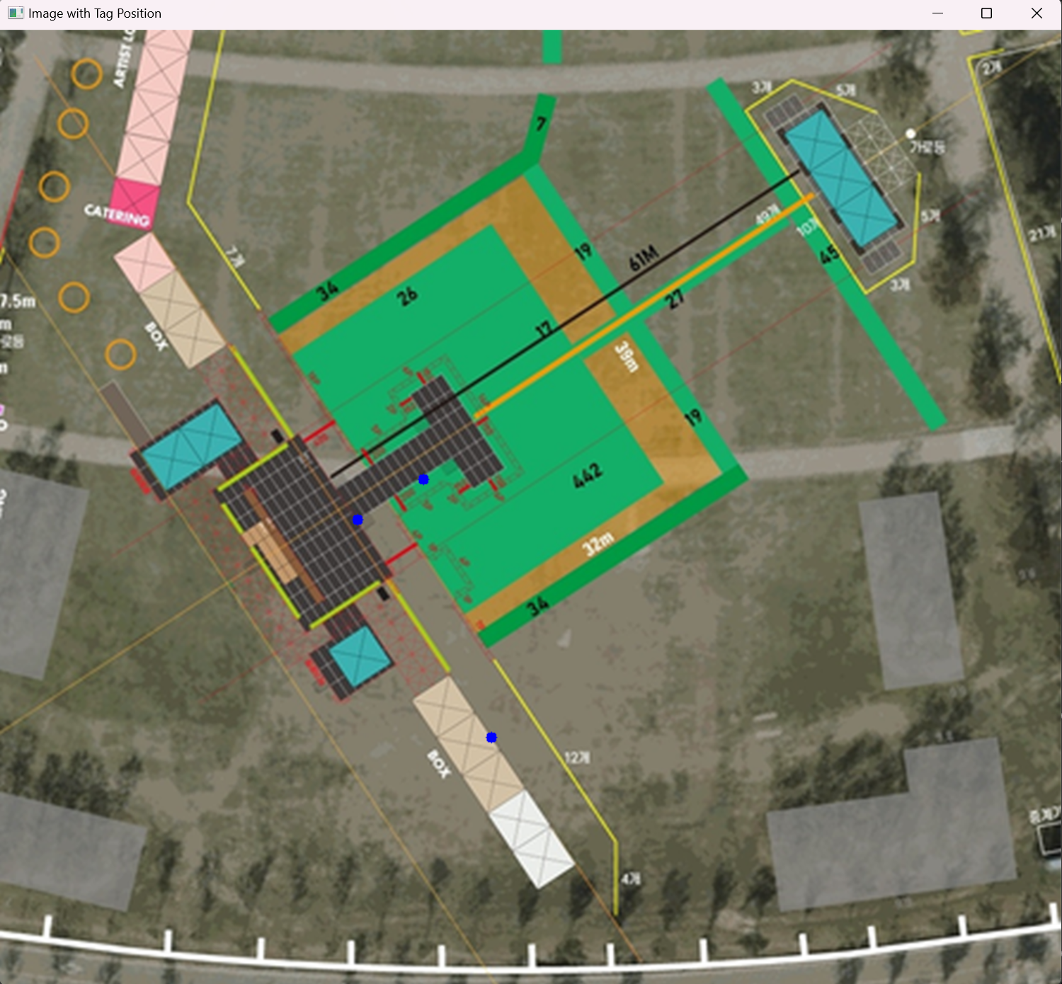

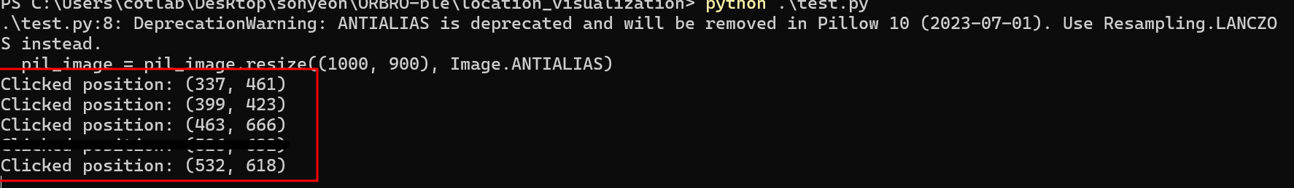

Slide 8
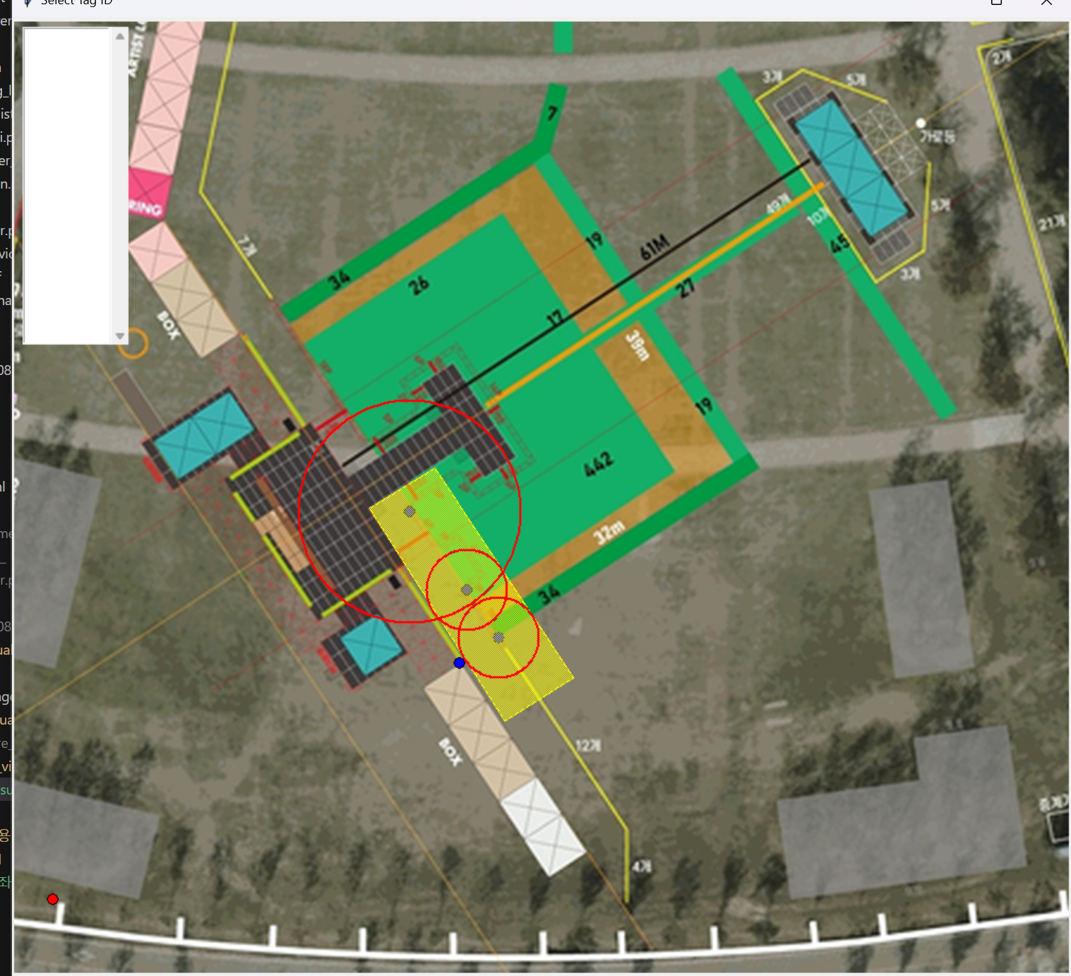
poi_rect = canvas.create_polygon(337, 461, 399, 423, 530, 621, 465, 662, fill='yellow', outline='yellow', stipple='gray50')

Slide 9
ㄴㅇㄹㄴㅇㄹㄴㅇㄹㄴㅇㄹㄴㅇ
ㅁㄴㅇㄻㄴㅇㄻㄴㅇㄻㄴㅇㄹ

